Slide 1
Course Substitution
EECS
A Guide for Students

Slide 2
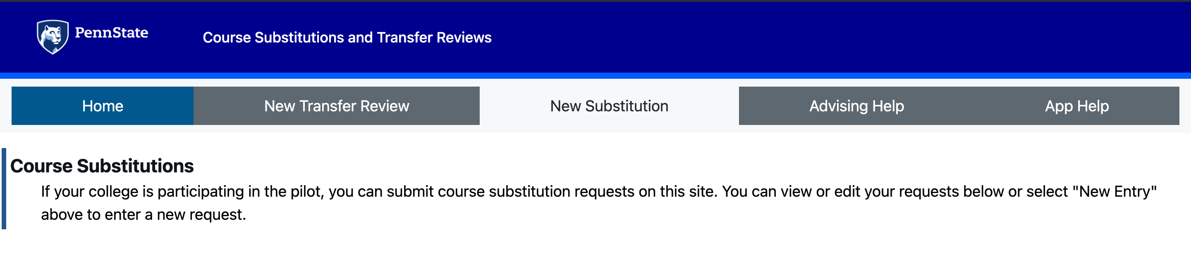
Overview
https://coursesub.psu.edu/
Site for course substitutions and transfer credits

Slide 3
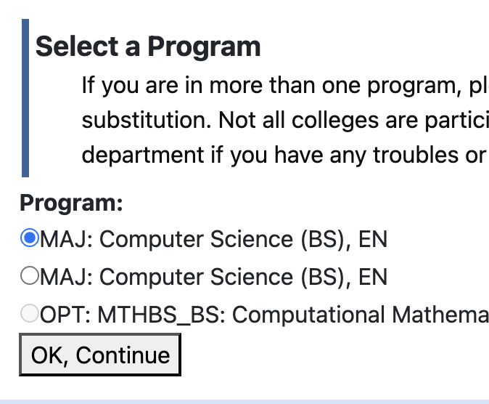
Select the Program
Select the program that you need to make a substitution for

Slide 4
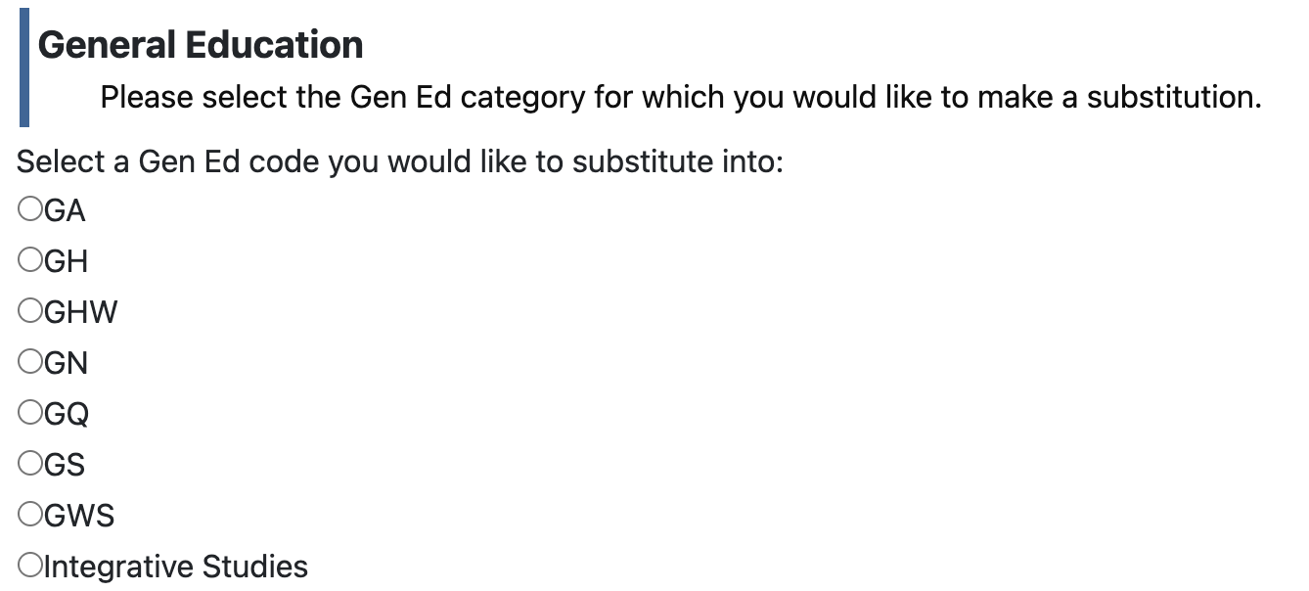
Types of Request – Gen Ed
When to use this: Only use this if a General Education course you have already taken is not automatically showing up in your degree audit.
Note: If the course is appearing in your audit but in the wrong Gen Ed category (e.g., it's counting as GA but you need it as GH), use this form to request the swap.

Slide 5
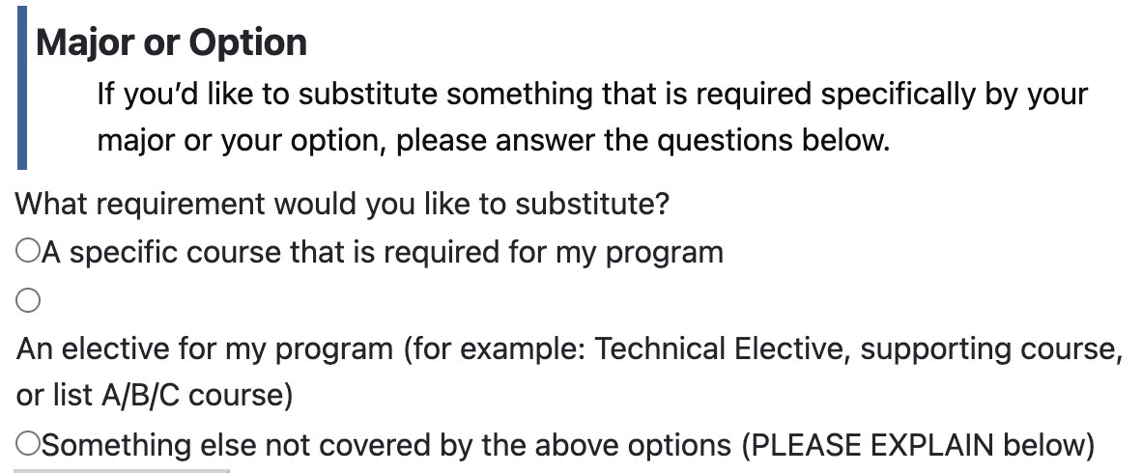
Types of Request - Major/Option
MOST COMMON REQUESTS!
Examples:
Petitioning 400 level and 4 credit elective (or Dept List) to count as FYS"
Step 1: Select Major/Option (Do NOT use the University "FYS" button).
Step 2: Choose "Something else not covered by the above options".
Step 3: In the explanation box, explicitly mention the course (or the specific Dept List course).
Step 4: Select "A course on my transcript" and choose the specific course
Natural Science Petitions
Use Case: Moving an extra 1 credit of Natural Science to satisfy FYS or Department List requirements.
Action: Follow the same steps as above (Select "Something else not covered").
AP Computer Science A for CMPSC 131
Action: Use this tab to apply AP CMPSC credits to your major requirements.
Missing CMPSC 131 Requirement despite taking it
ENGL 202H for ENGL 202C
Must file petition for Foreign Language Req (will be eliminated after Sp 27)
Remember to attach your transcript!!
Must file petition for Supporting Courses (will be eliminated after Sp 27)
Petition BEFORE you take them

Slide 6
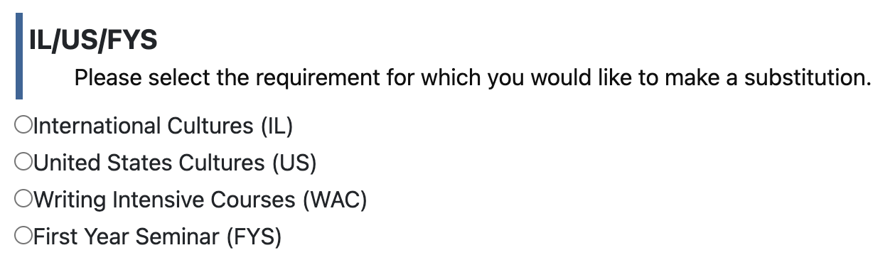
Types of Request - University Requirement/FYS
DO NOT use FYS option after major declaration, please consult advisor.
When to use this: Only use this button if you missed taking an FYS in your first year, but you successfully took a valid FYS course (like ENGR 100) in your second year and need it applied to the requirement.

Slide 7
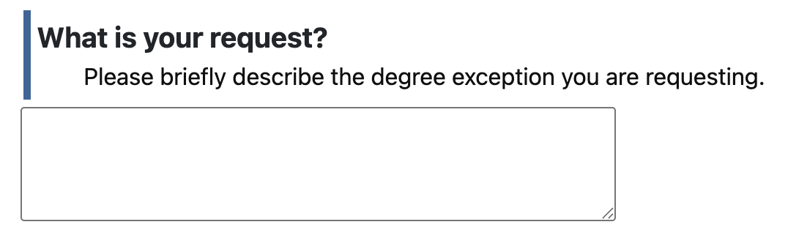
Types of Request – Other
This is primarily for complex exceptions, such as having too many transfer credits and needing a specific waiver (please be thorough)
Most standard course substitutions should use the Major/Option tab instead!
Just see your advisor!

